Slide 1
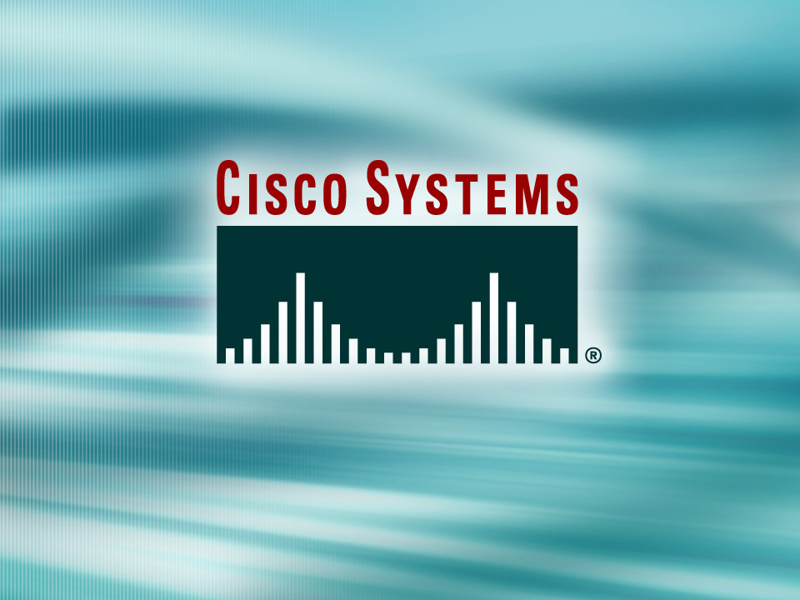
© 2002, Cisco Systems, Inc. All rights reserved.

Slide 2
Managing Your Network Environment
Module 2
Notes:
Purpose: This chapter introduces the Cisco IOS™ CLI on the Catalyst® 1900 switch and router.
Timing: This chapter should take about 2 hours to present.
Note: The Catalyst 1900 switch only has a subset of the router Cisco IOS commands available.
Contents:
Introduction to Cisco IOS. Explain to the student what is IOS?
Cisco Device startup procedures in general.
IOS configuration source.
General introduction to the IOS CLI.
Cat 1900 switch startup procedures.
Intro to Cat 1900 CLI. This part covers the basic configuration on the switch, like setting the IP address and hostname. More details about the various Cat 1900 switch configuration commands are explained in Chapter 6 and 7.
Router startup procedures. More details on the router startup process is discussed in chapter 5.
Router IOS CLI.

Slide 3
Objectives
Upon completing this module, you will be
able to:
  Use the command-line interface to accurately determine network operational status and network performance
  Manage operating system image files to maintain an accessible operating system file and according to best practices, given a network topology
  Use Cisco IOS commands to manage device configuration files to reduce device downtime and according to best practices
  Execute an add, move, or change so that the network functions in accordance with the new requirement, given a new network requirement
Notes:
Slide 1 of 2
Purpose: This slide states the chapter objectives.
Emphasize: Read or state each objective so that each student has a clear understanding of the chapter objectives.
Note: Catalyst switches have different CLIs. The Catalyst 2900xl and the Catalyst 1900 has a Cisco IOS CLI. The Cisco IOS CLI commands available on the 2900xl is different from the 1900. The Catalyst 5000 family has no Cisco IOS CLI, and use the set commands instead. This class only covers the configuration on the Catalyst 1900 switch.

Slide 4

Discovering Neighbors on the Network
© 2002, Cisco Systems, Inc. All rights reserved.
Notes:
Purpose: This chapter introduces the Cisco IOS™ CLI on the Catalyst® 1900 switch and router.
Timing: This chapter should take about 2 hours to present.
Note: The Catalyst 1900 switch only has a subset of the router Cisco IOS commands available.
Contents:
Introduction to Cisco IOS. Explain to the student what is IOS?
Cisco Device startup procedures in general.
IOS configuration source.
General introduction to the IOS CLI.
Cat 1900 switch startup procedures.
Intro to Cat 1900 CLI. This part covers the basic configuration on the switch, like setting the IP address and hostname. More details about the various Cat 1900 switch configuration commands are explained in Chapter 6 and 7.
Router startup procedures. More details on the router startup process is discussed in chapter 5.
Router IOS CLI.

Slide 5
Objectives
Upon completing this lesson, you will be able to:
  Determine the host names and addresses of neighboring Cisco devices using CDP, given operational access layer switches and routers
  Use information gathered using CDP to create a network map of the environment, given operational access layer switches and routers
Notes:
Slide 1 of 2
Purpose: This slide states the chapter objectives.
Emphasize: Read or state each objective so that each student has a clear understanding of the chapter objectives.
Note: Catalyst switches have different CLIs. The Catalyst 2900xl and the Catalyst 1900 has a Cisco IOS CLI. The Cisco IOS CLI commands available on the 2900xl is different from the 1900. The Catalyst 5000 family has no Cisco IOS CLI, and use the set commands instead. This class only covers the configuration on the Catalyst 1900 switch.

Slide 6
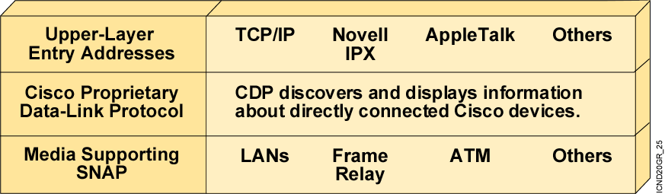
Cisco Discovery Protocol
  CDP is a proprietary utility that gives you a summary of directly connected switches, routers, and other Cisco devices.
  CDP discovers neighboring devices regardless of which protocol suite they are running.
  Physical media must support the Subnetwork Access Protocol (SNAP) encapsulation.
Notes:
Note: CDP is sent using multicast frames with the MAC address 0100.0ccc.cccc.

Slide 7
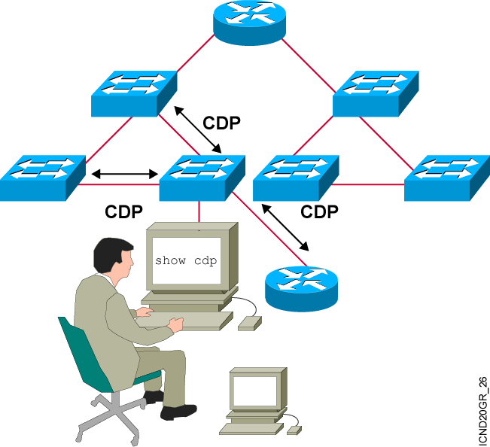
Discovering Neighbors with CDP
CDP runs on routers with Cisco IOS®
software Release 10.3 or later and on Cisco switches and hubs.
Summary information
includes:
  Device identifiers
  Address list
  Port identifier
  Capabilities list
  Platform
Notes:
Emphasize: CDP is media- and protocol-independent and runs on all Cisco-manufactured equipment including routers, access servers, switches, and some managed hubs. With CDP, network management applications can retrieve the device type and SNMP agent address of neighboring devices. This capability enables applications to send SNMP queries to neighboring devices.
CDP allows network management applications to dynamically discover Cisco devices that are neighbors. CDP runs on all media that support the Subnetwork Access Protocol, including LAN and Frame Relay. CDP runs over the data link layer only, not the network layer. Therefore, two systems that support different network-layer protocols can learn about each other.
Cached CDP information is available to network management applications. Cisco devices never forward a CDP packet. When new information is received, old information is discarded. The holdtime determines how long to keep existing information from a neighbor.

Slide 8
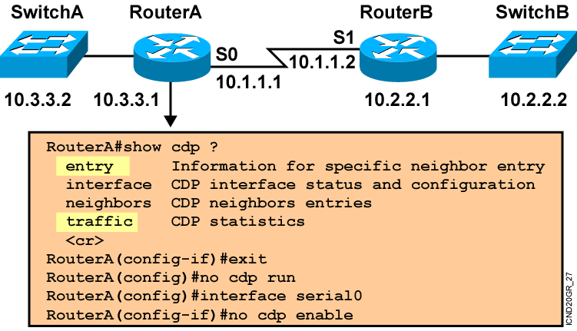
Using CDP
Notes:
Note: Some of the CDP commands are not available on the Catalyst 1900 switch, like cdp run, show cdp traffic, and show cdp entry.

Slide 9
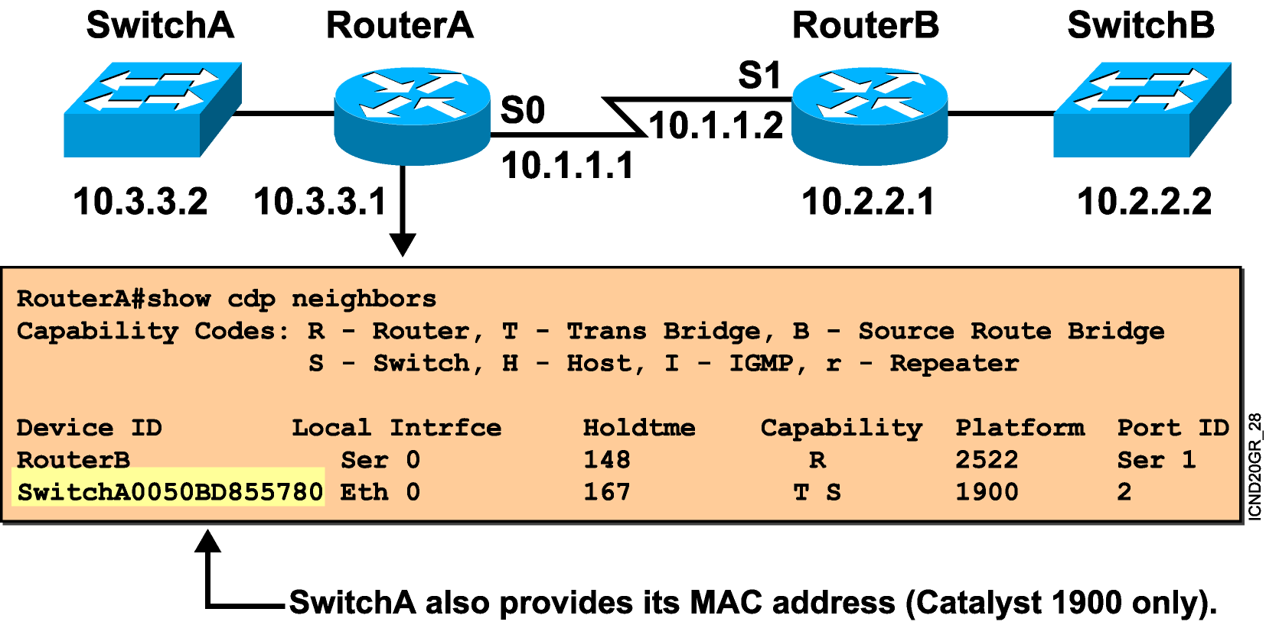
Using the show cdp neighbors Command
Notes:
Emphasize: This graphic shows the show cdp neighbors command initiated from a router, which displays a summary of the capabilities and access details for the CDP neighbors. The show cdp neighbors detail command shows detailed information about the same devices.
Note: If the neighbor is a Catalyst 1900 switch, the switch MAC address is also displayed. If the switch is a 2900xl, its MAC address is not displayed.

Slide 10
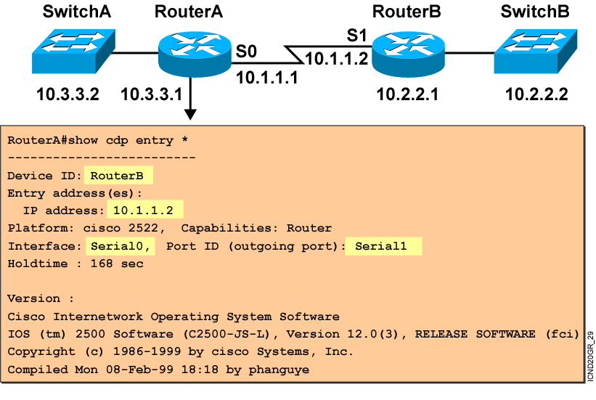
Using the show cdp entry Command
Notes:
Emphasize: The example shows what information can be obtained about RouterA’s neighbor. CDP is one way to learn about other Cisco devices on the network.

Slide 11
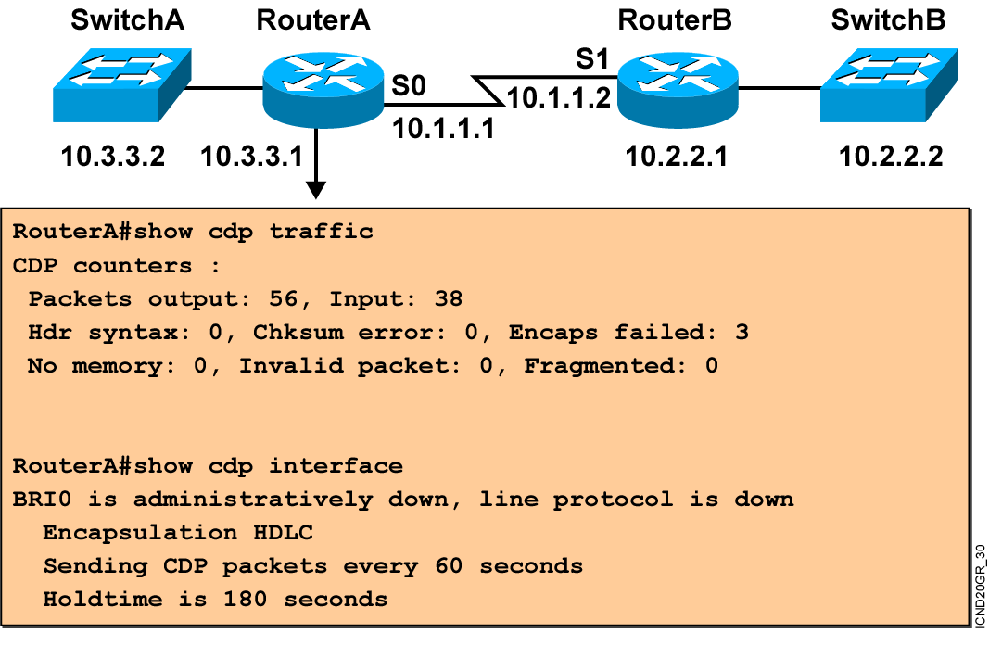
Additional CDP Commands
Notes:
Note: The holdtime indicates how long the neighbor information will be kept in the local CDP table.

Slide 12
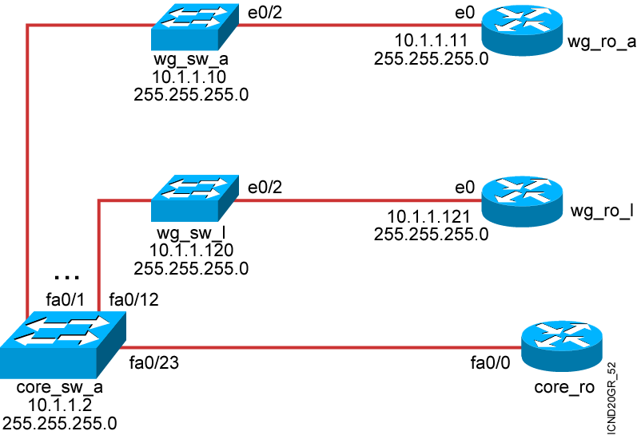
Creating a Network Map

Slide 13
Summary
  Cisco Discovery Protocol is an information-gathering tool used by network administrators to get information about directly connected devices.
  CDP exchanges hardware and software device information with its directly connected CDP neighbors.
  You can enable or disable CDP on a router as a whole or on a port-by-port basis.
Notes:
Purpose: This slide discuss the initial configurations on the routers and switches.
Note: There is no setup mode on the Catalyst 1900 switch.

Slide 14
Summary (Cont.)
  The show cdp neighbors command displays information about a router’s CDP neighbors.
  The show cdp entry, show cdp traffic, and show cdp interface commands display detailed CDP information on a Cisco device.
  After you use CDP to discover the devices on the internetwork, you should document the network so you understand and can support the network.

Slide 15


